Slide 1





RAPtwin : A Digital Twin Simulation Platform for Distributed Systems
Presented by: PID-1
Class : TY AIDS(A)
Guided by : K. K. Deshmukh
Notes:
1.7.2013
NOTE:
To change the image on this slide, select the picture and delete it. Then click the Pictures icon in the placeholder to insert your own image.
‹#›
‹#›

Slide 2

Outline
    Introduction
    Problem Statement
    Objectives
    Literature Review
    Methodology(Block diagram,Proposed approach,Techniques,tools)
    Expected Outcomes (Input,Output)
    Summary (Key takeaways from seminar)
    References(List of papers and sources referred)
RAPtwin : A Digital Twin Simulation Platform for Distributed Systems
2
18/09/2026
Notes:
1.7.2013
‹#›

Slide 3
Introduction
Modern distributed computing infrastructures including cloud, edge, and hybrid environments are characterized by dynamic workloads, heterogeneous hardware, and unpredictable failures. Testing and optimizing such systems in real world environments is both costly and risky, as even minor misconfigurations can lead to significant service disruptions. Existing simulation tools lack the capability to combine Digital Twin modeling, intelligent scheduling strategies, and resilience testing in a unified platform. Therefore, there is a critical need for a safe, scalable, and comprehensive simulation environment that enables researchers and engineers to evaluate infrastructure behavior, experiment with resource management strategies, and assess system resilience without impacting live systems. RAPtwin addresses this need by providing a Digital Twin-based simulation platform that integrates scheduling policy experimentation, chaos engineering, predictive analytics, and performance monitoring in a single unified framework.
RAPtwin : A Digital Twin Simulation Platform for Distributed Systems
3
18/09/2026
Notes:
1.7.2013
‹#›

Slide 4
Problem Statement
To address the lack of safe and scalable experimentation platforms for distributed computing infrastructure by developing a digital twin based simulation environment that enables testing of scheduling strategies, fault injection, and resource optimization without impacting real systems.
RAPtwin : A Digital Twin Simulation Platform for Distributed Systems
4
18/09/2026
Notes:
1.7.2013
‹#›

Slide 5
Objectives
    To Develop a comprehensive digital twin and planning sandbox for distributed computing fabrics.
    To implement a multi strategy scheduling engine supporting greedy, resilient, network aware, and reinforcement learning-based policies for comparative analysis across distributed workloads.
    To simulate real world failures such as network faults and node crashes to validate scheduling policy resilience before actual deployment.
    To provide an interactive dashboard for performance analytics and simulations, enabling users to monitor system behavior and support informed infrastructure planning decisions.
    To maintain real time synchronization between the digital twin and physical infrastructure by continuously integrating hardware data with live telemetry for accurate system representation
RAPtwin : A Digital Twin Simulation Platform for Distributed Systems
5
18/09/2026
Notes:
1.7.2013
‹#›

Slide 6
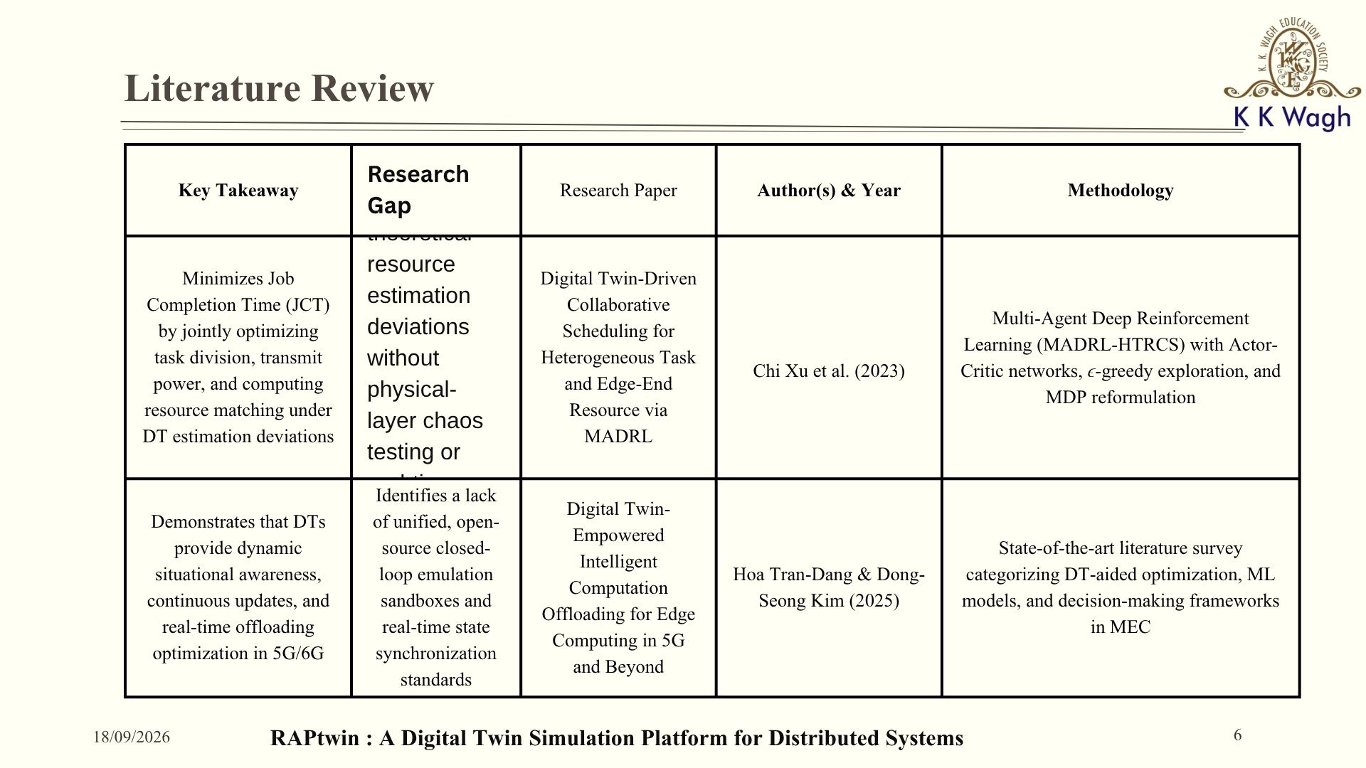

Slide 7
Literature Review
Research Paper | Author(s) & Year | Methodology | Key Takeaway | Research Gap
Digital Twin: Enabling Technologies, Challenges and Open Research | Aidan Fuller et al. (2020) | Categorical literature review classifying DT architectures across manufacturing, healthcare, and smart cities | Clarifies DT definitions (Digital Model vs. Shadow vs. Twin) and maps functional domains across application, middleware, network, and object layers | Highlights the lack of standardized modeling frameworks and gaps in integrating physical and virtual data streams
A Comprehensive Survey on Digital Twin for Future Networks and Emerging IoT Industry | Akram Hakiri et al. (2024) | Comprehensive survey evaluating DT software frameworks, international standards (DTC, ISO, IETF), and IoT/5G projects | Defines core DT properties (reflection, persistency, composability) and details reference architectures across 5G/6G and IIoT | Notes software fragmentation, lack of cell-based microservices, and absence of standardized fault-tolerance testing tools
RAPtwin : A Digital Twin Simulation Platform for Distributed Systems
7
18/09/2026
Notes:
1.7.2013
‹#›

Slide 8
Literature Review
Research Paper | Author(s) & Year | Methodology | Key Takeaway | Research Gap
Federated Deep Reinforcement Learning for Task Offloading in Digital Twin Edge Networks | Yueyue Dai et al. (2024) | Two-layer DT Edge Network combined with Federated DRL (global agent using DDPG for edge resources/IRS; local agents for task offloading) | Reduces overall system cost (latency + energy) by up to 67.1% while maintaining localized training privacy | Does not incorporate physical hardware derating (e.g., thermal throttling) or live streaming telemetry overrides
Digital Twins: A Survey on Enabling Technologies, Challenges, Trends and Future Prospects | Stefan Mihai et al. (2022) | Broad literature survey exploring the 5D DT model, enabling technologies (ML, Cloud/Edge, CPS, VR/AR), and 3 industrial case studies | Establishes DT as a symbiotic system-of-systems requiring bi-directional feedback, self-evolution, and real-time synchronicity | Identifies high investment costs, lack of standardized development methodologies, and difficulty quantifying ROI for non-revenue-generating sandboxes
RAPtwin : A Digital Twin Simulation Platform for Distributed Systems
8
18/09/2026
Notes:
1.7.2013
‹#›

Slide 9
Literature Review
Research Paper | Author(s) & Year | Methodology | Key Takeaway | Research Gap
Chaos Experiments in Microservice Architectures: A Systematic Literature Review | Emrah Esen et al. (2026) | Systematic Literature Review (SLR) of 31 primary studies analyzing 38 Chaos Engineering fault-injection tools | Proves that controlled chaos experiments significantly improve software fault tolerance, security, and steady-state resilience | Microservice chaos tools focus almost exclusively on application/software-level failures rather than physical-layer edge hardware disruptions
RAPtwin : A Digital Twin Simulation Platform for Distributed Systems
9
18/09/2026
Notes:
1.7.2013
‹#›

Slide 10
Scope
    Simulated digital twin of a heterogeneous compute fabric (edge, campus, cloud-tier nodes)
    Job placement/scheduling across multiple strategies greedy, resilient/federated, RL Markov.
    Chaos engineering controlled fault injection (node failure, thermal derating, link loss/latency)
    Predictive analytics utilization forecasts, failure-window prediction, reliability scoring
    Monte Carlo based statistical evaluation of scheduling strategies under randomized conditions
    Optional container based emulation (Docker) for closer-to-real testing beyond pure simulation
    Interactive dashboard + REST API + CLI for running and observing experiments
RAPtwin : A Digital Twin Simulation Platform for Distributed Systems
10
18/09/2026
Notes:
1.7.2013
‹#›

Slide 11
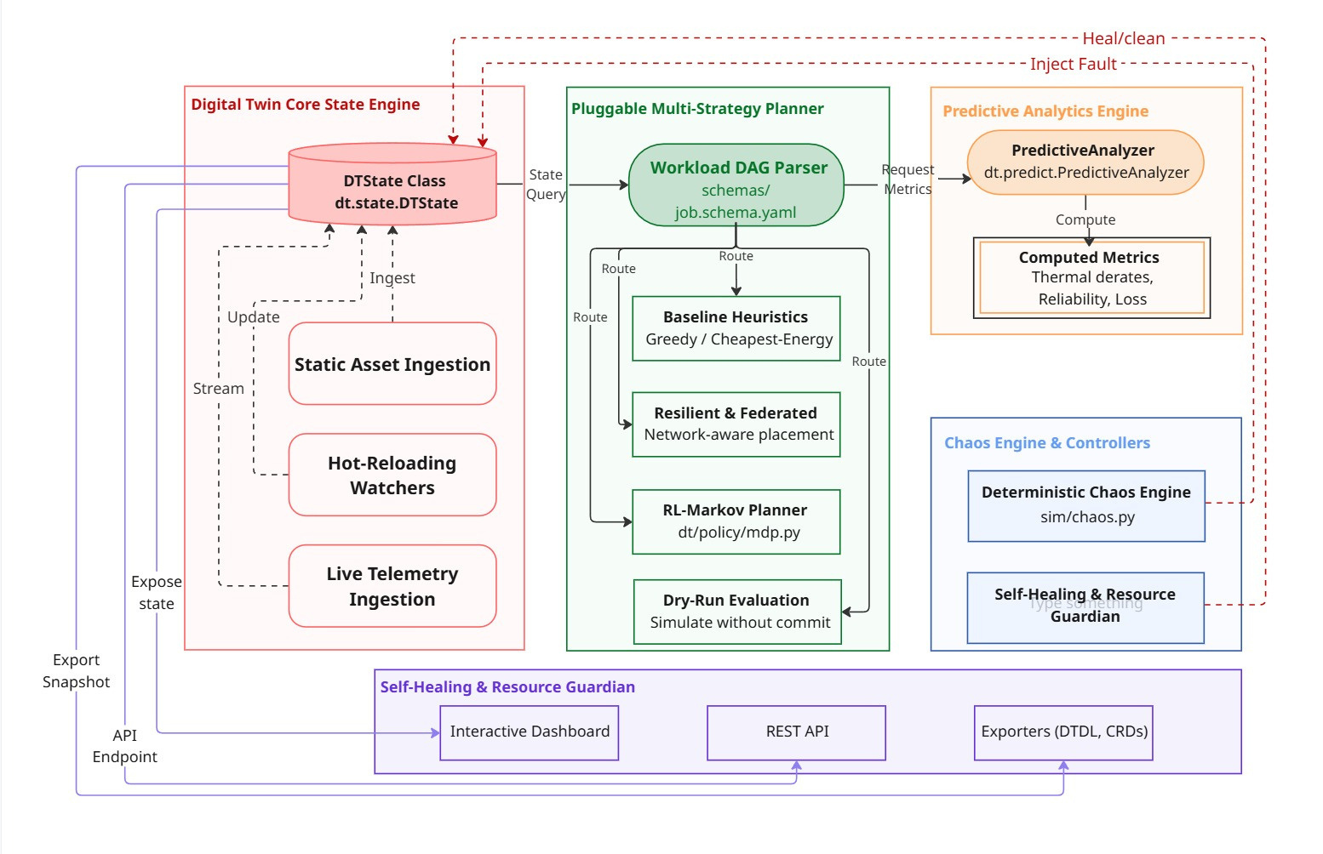
Methodology - RAP twin Core Architecture
RAPtwin : A Digital Twin Simulation Platform for Distributed Systems
11
18/09/2026
Notes:
1.7.2013
‹#›

Slide 12
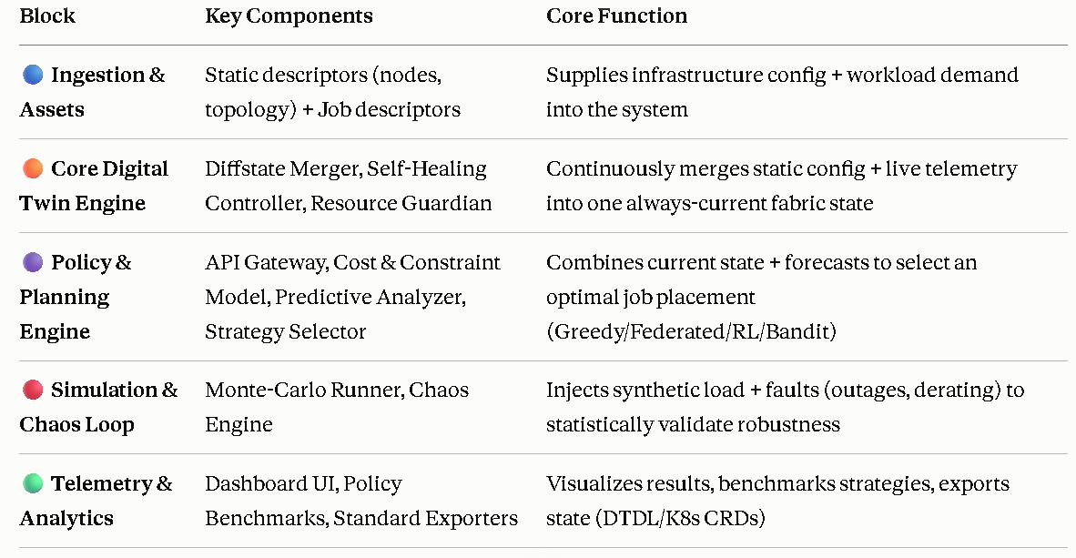
Methodology - RAP twin Core Architecture
RAPtwin : A Digital Twin Simulation Platform for Distributed Systems
12
18/09/2026
Notes:
1.7.2013
‹#›

Slide 13
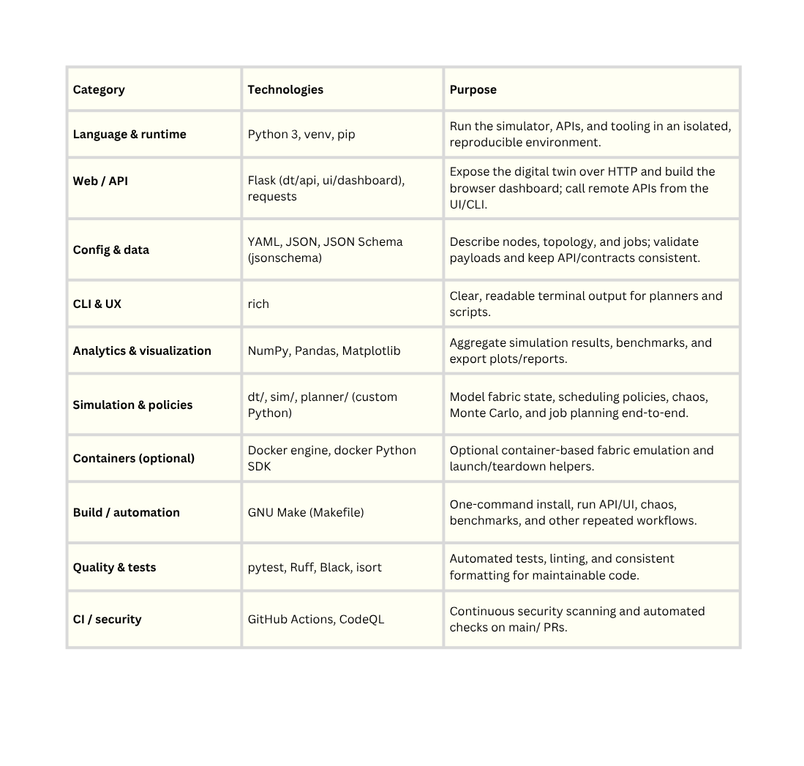
Tools And Technologies :
Techniques :
    Digital Twin Modeling for Distributed Fabric State
    Declarative Topology and Node Descriptor Driven Simulation
    Multi Strategy Job Placement and Scheduling (Greedy, Resilient, Federated, Bandit, RL / MDP Oriented Policies)
    Monte Carlo Simulation for Workload and Policy Evaluation
    Chaos Engineering and Fault Injection via Scenario Schedules
    Predictive Analytics for Utilisation, Risk, and Reliability Forecasting
    Hybrid Static Dynamic Configuration (YAML/JSON Schemas + Live Overrides and Observations)
    Closed Loop Validation (Plan → Reserve → Observe → Re-Plan)
    Policy Benchmarking and Comparative Metrics Visualization
    Optional Container Based Fabric Emulation for End to End Testbeds
RAPtwin : A Digital Twin Simulation Platform for Distributed Systems
8
18/09/2026
Notes:
1.7.2013
‹#›

Slide 14
Requirement Specification
1. Functional Requirements
    System shall allow generation of synthetic node descriptors and network topology
    System shall accept job descriptors (YAML/JSON) with stages, resource needs, deadlines, and fault tolerance settings
    System shall validate job/topology/node files against defined JSON schemas
    System shall support multiple scheduling strategies (greedy, resilient, federated, bandit, RL Markov) selectable at runtime
2. Non-Functional Requirements
    Performance: Planner should return placement decisions with low latency (near real time) for interactive use in the dashboard
    Scalability: Should handle at least tens of simulated nodes and jobs with multiple stages without degradation
    Reliability: Self healing controller and resource guardian should recover from expired reservations / degraded nodes automatically
RAPtwin : A Digital Twin Simulation Platform for Distributed Systems
14
18/09/2026
Notes:
1.7.2013
‹#›

Slide 15
Expected Outcomes (Inputs & Outputs)
    System Inputs:
      Static node/topology descriptors (YAML).
      Complex workload descriptors (JSON/YAML) with strict SLA deadlines, resource constraints, and fault-tolerance rules.
      Live telemetry and deterministic chaos schedules.
    System Outputs:
      Actionable placement plans mapping tasks to the optimal edge nodes.
      Statistical proofs (CSVs) demonstrating that intelligent policies (Federated/RL) minimize system cost, latency, and energy compared to static baselines.
      Real time topology visualizations showing predictive hardware health
RAPtwin : A Digital Twin Simulation Platform for Distributed Systems
15›
18/09/2026
Notes:
1.7.2013
‹#›

Slide 16
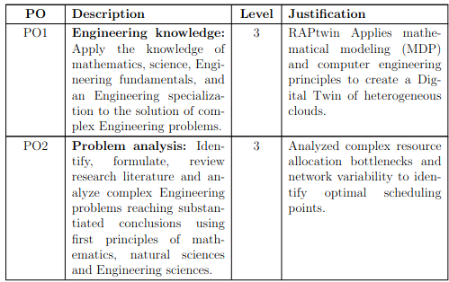
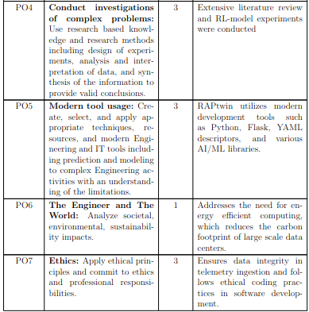
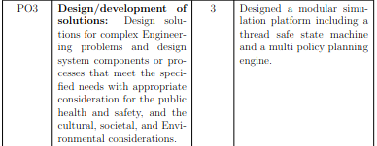
Program Outcome (PO) Mapping
RAPtwin : A Digital Twin Simulation Platform for Distributed Systems
16
18/09/2026
Notes:
1.7.2013
‹#›

Slide 17
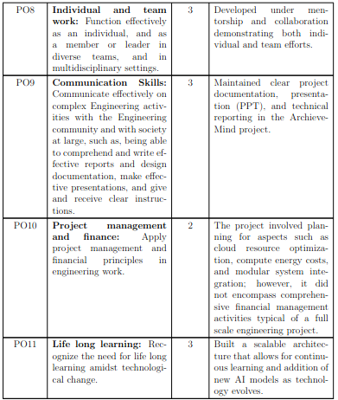
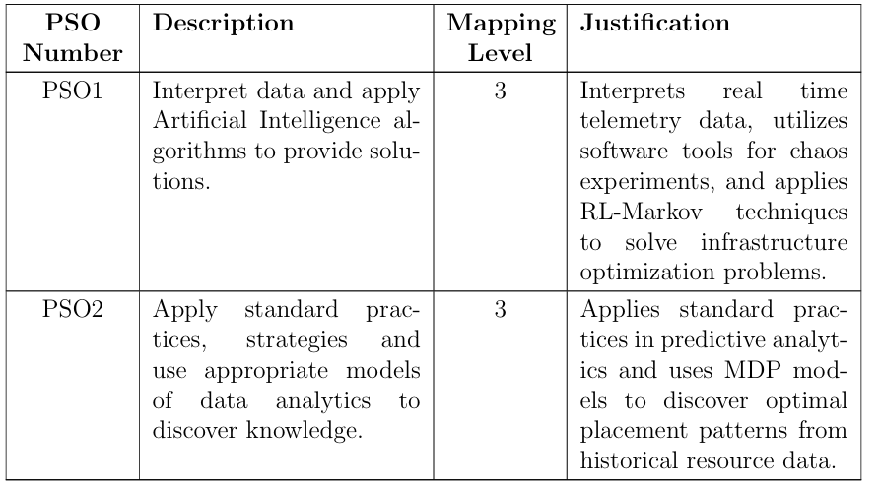
Program Outcome (PO) Mapping
RAPtwin : A Digital Twin Simulation Platform for Distributed Systems
17
18/09/2026
Notes:
1.7.2013
‹#›

Slide 18
Performance Parameters
  Planning Speed – Time taken to assign a job to the right machine; slower planning delays job start
  Job Latency & Deadline Hit Rate – Whether jobs finish within their set deadline; tracked as average, worst case, and % on time
  Energy Used – Estimated power cost of running a job on a chosen node; can be optimized instead of speed
  Reliability & Risk – Likelihood of a node or link failing; system avoids risky placements and self-heals
  Resource Usage – Live view of free vs. used CPU, memory, and GPU on each node
  Network Quality – Speed, delay, and data loss between nodes; affects how fast job stages exchange data
  System Responsiveness – How quickly the system detects changes like failures or file edits; updates pushed instantly with a backup check every 30s
RAPtwin : A Digital Twin Simulation Platform for Distributed Systems
18
18/09/2026
Notes:
1.7.2013
‹#›

Slide 19
Efficiency Issues
  Rechecks Everything Too Often – System scans all node files every 0.5s; one small change reloads all files, not just the changed one
  One Lock Blocks Everything – A single lock controls all actions, so requests wait in line instead of running together
  Copies All Data Every Time – Every status check duplicates the entire system state, even with no change
  Simulation Copies Too Much – Test runs duplicate all node/link data on every single trial, wasting time
  Requests Sent One by One – Network calls go out individually instead of in batches, slowing simulations
  Repeats Work Unnecessarily – Planner recalculates the same results for every job step instead of reusing them
RAPtwin : A Digital Twin Simulation Platform for Distributed Systems
19›
18/09/2026
Notes:
1.7.2013
‹#›

Slide 20
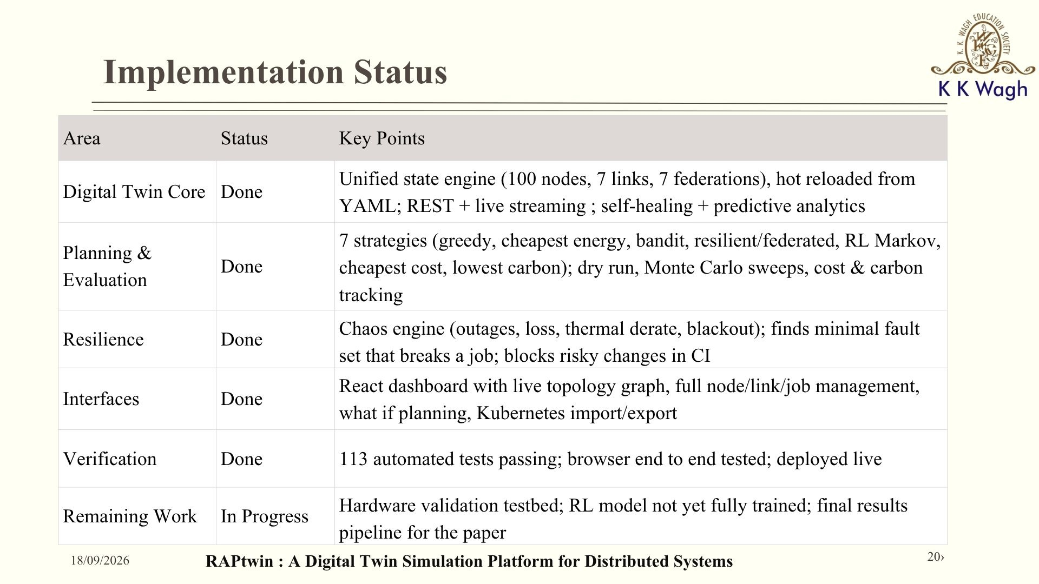

Slide 21
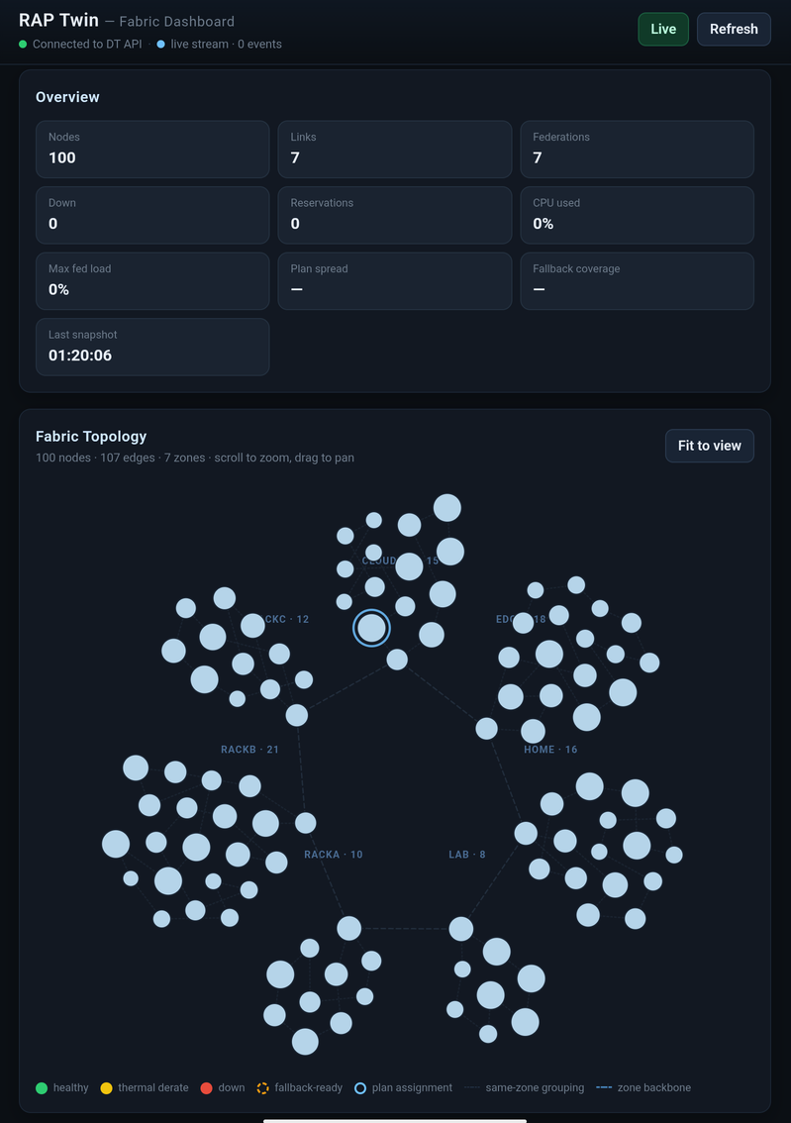
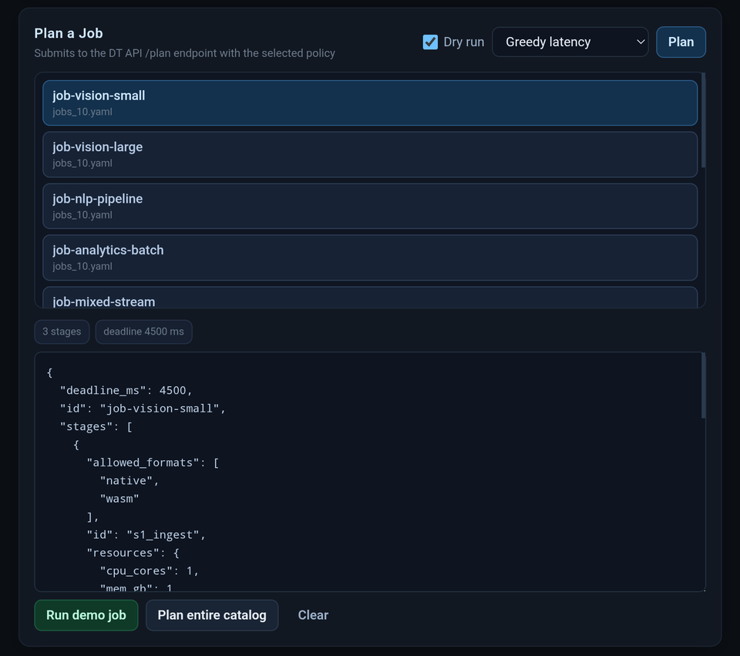
Working modules / Simulation
Working Simulation : https://raptwin.seloraos.online/
Your paragraph text
Your paragraph text
RAPtwin : A Digital Twin Simulation Platform for Distributed Systems
21
18/09/2026
Notes:
1.7.2013
‹#›

Slide 22
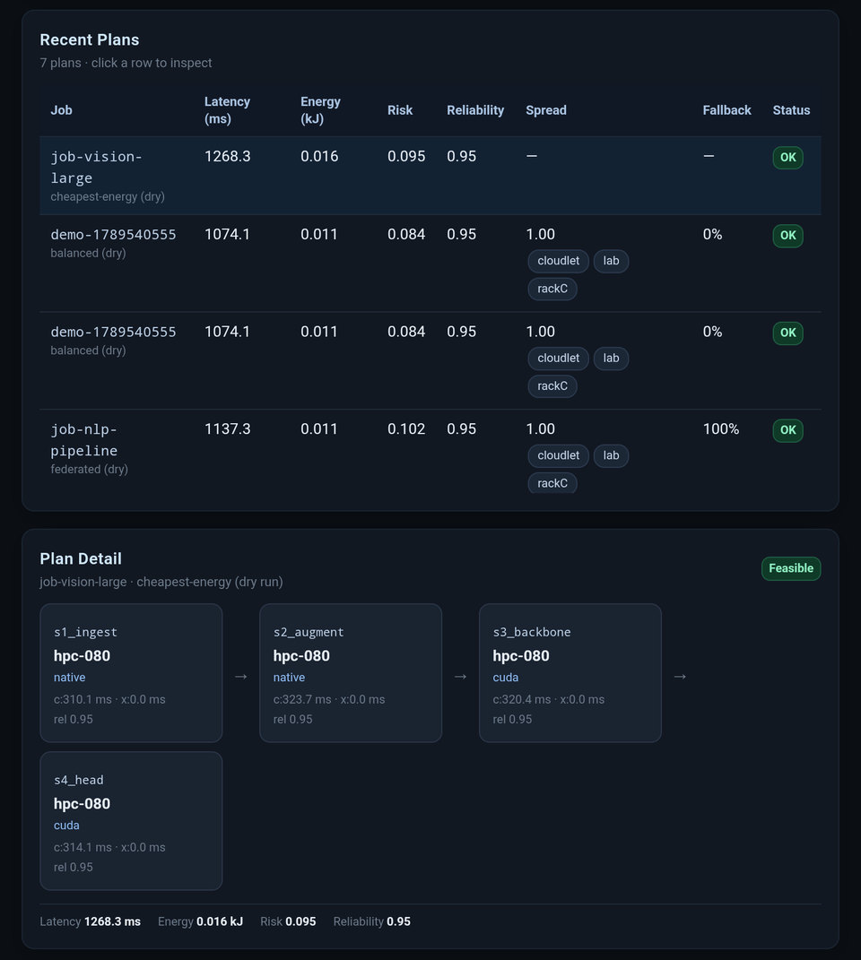
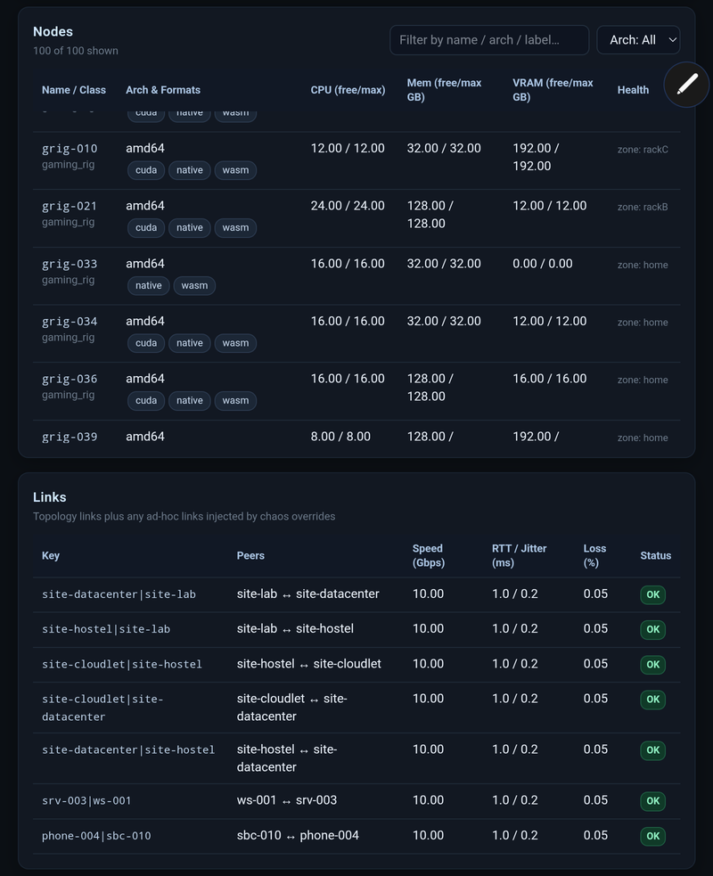
Working modules / Simulation
RAPtwin : A Digital Twin Simulation Platform for Distributed Systems
22
18/09/2026
Notes:
1.7.2013
‹#›

Slide 23
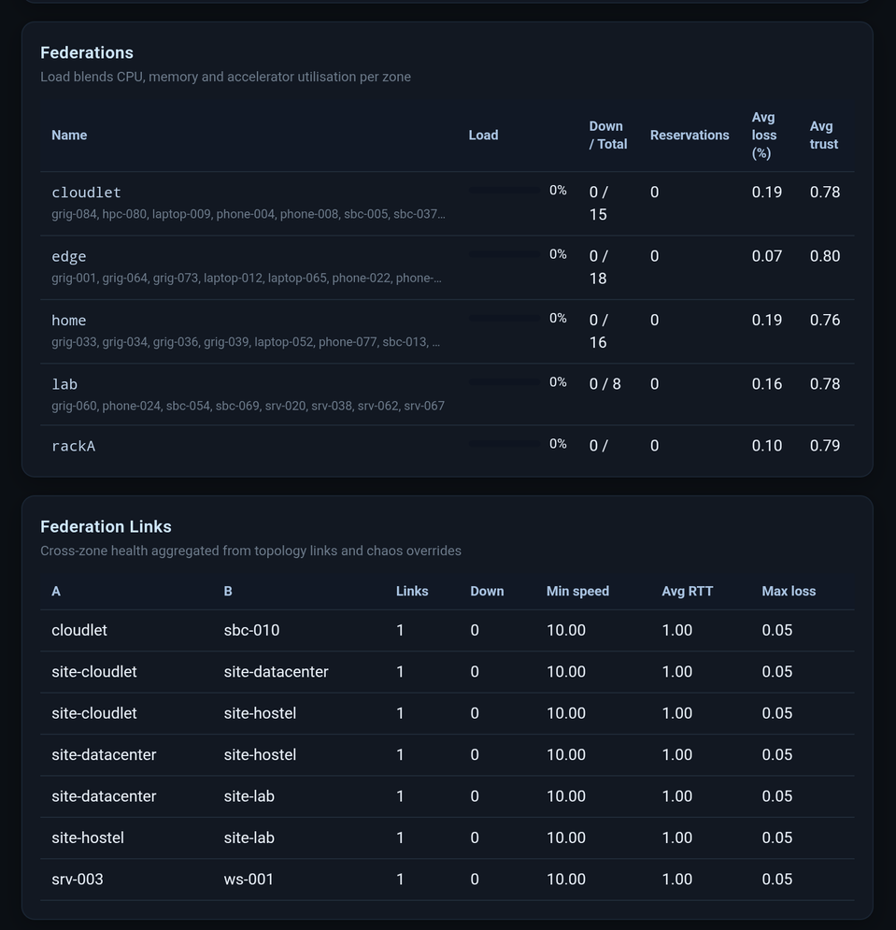
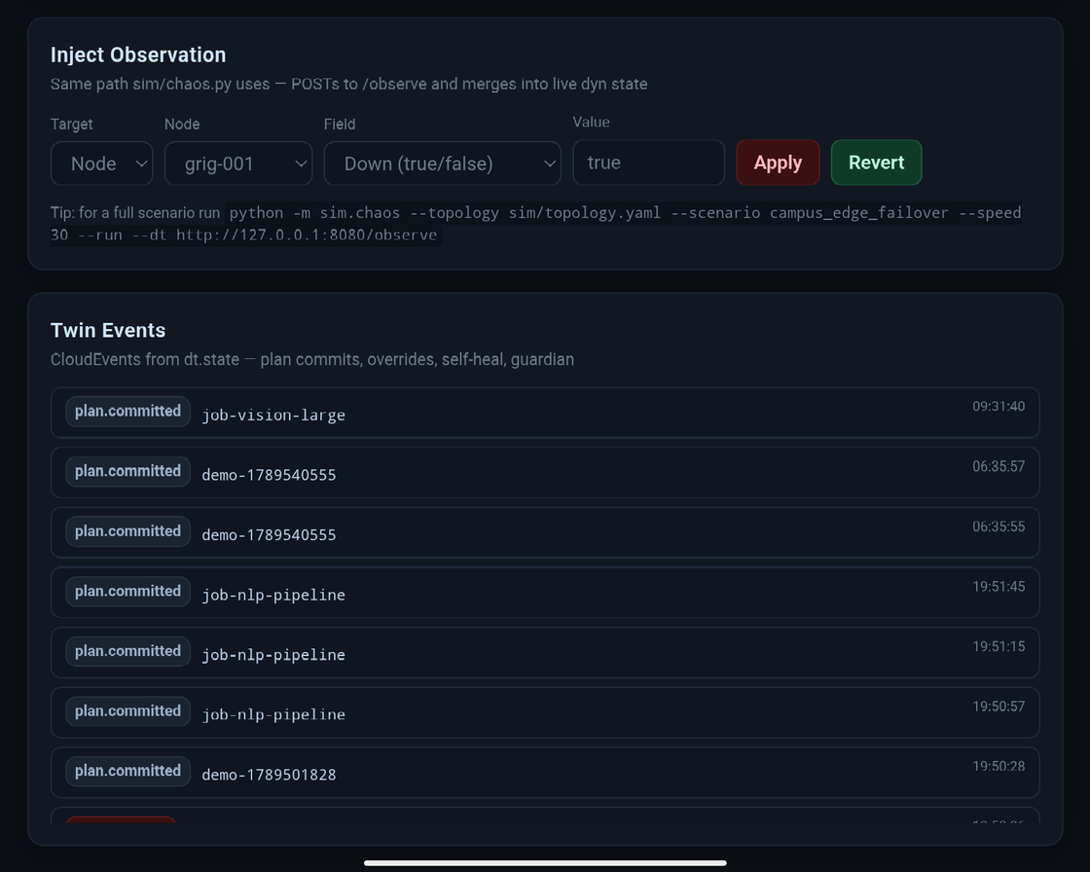
Working modules / Simulation
RAPtwin : A Digital Twin Simulation Platform for Distributed Systems
23
18/09/2026
Notes:
1.7.2013
‹#›

Slide 24
Conclusion
This research proposes a framework in which physical devices are paired with virtual twins that continuously mirror their real-time status and operating conditions. Using these digital counterparts, the system determines whether a device should execute tasks locally or offload them to external servers, optimizing performance and resource use. By integrating AI and probabilistic models, the framework runs virtual simulations in advance to identify the most battery-efficient and fastest execution paths before tasks are carried out in the real world. It further aims to improve network reliability by enabling these twins to dynamically adapt to glitches and high connectivity demands, while leveraging real-time data to balance CPU usage and bandwidth, ensuring seamless and lag-free operation of critical services such as smart factories.
RAPtwin : A Digital Twin Simulation Platform for Distributed Systems
24
18/09/2026
Notes:
1.7.2013
‹#›

Slide 25
References
    C. Xu et al., "Digital Twin-Driven Collaborative Scheduling for Heterogeneous Task and Edge-End Resource via Multi-Agent Deep Reinforcement Learning," IEEE Journal on Selected Areas in Communications, 2023.
    S. Mihai et al., "Digital Twins: A Survey on Enabling Technologies, Challenges, Trends and Future Prospects," IEEE Communications Surveys & Tutorials, vol. 24, no. 4, pp. 2255–2291, 2022.
    E. Esen et al., "Chaos Experiments in Microservice Architectures: A Systematic Literature Review," Computer Standards & Interfaces, Elsevier, 2026.
    H. Tran-Dang and D.-S. Kim, "Digital Twin-Empowered Intelligent Computation Offloading for Edge Computing in the Era of 5G and Beyond: A State-of-the-Art Survey," ICT Express, Elsevier, 2025.
    A. Fuller et al., "Digital Twin: Enabling Technologies, Challenges and Open Research," IEEE Access, vol. 8, pp. 108952–108971, 2020.
    A. Hakiri et al., "A Comprehensive Survey on Digital Twin for Future Networks and Emerging Internet of Things Industry," Computer Networks, Elsevier, 2024.
    Y. Dai et al., "Federated Deep Reinforcement Learning for Task Offloading in Digital Twin Edge Networks," IEEE Transactions on Network Science and Engineering, 2024.
    RAP twin Core Architecture, "RAP twin: Distributed Fabric Simulation and Planning Sandbox Repository & Technical Specification," System Documentation and Analysis, 2026.
RAPtwin : A Digital Twin Simulation Platform for Distributed Systems
25
18/09/2026
Notes:
1.7.2013
‹#›

Slide 26
THANK YOU !!
26
Notes:
1.7.2013
‹#›

